Slide 1
Capstone Project Presentation
Mohammad Hamza

Slide 2
Problem Definition
Identify sentence similarity between Questions asked by different users using provided dataset.

Slide 3
Solution Overview
Extract keywords from questions and run them through model to predict similarity.

Slide 4
Steps involved in solving the problem
Use SpaCy to extract keywords such as Noun, Proper Noun, Adjective, Verb from each column.
Remove Stop Words and Punctuation
Tokenize each column and convert to array.
Create Embedding Matrix for each column.
Create 2 input LSTM model using Keras Functional API.
Fit model on test data.

Slide 5
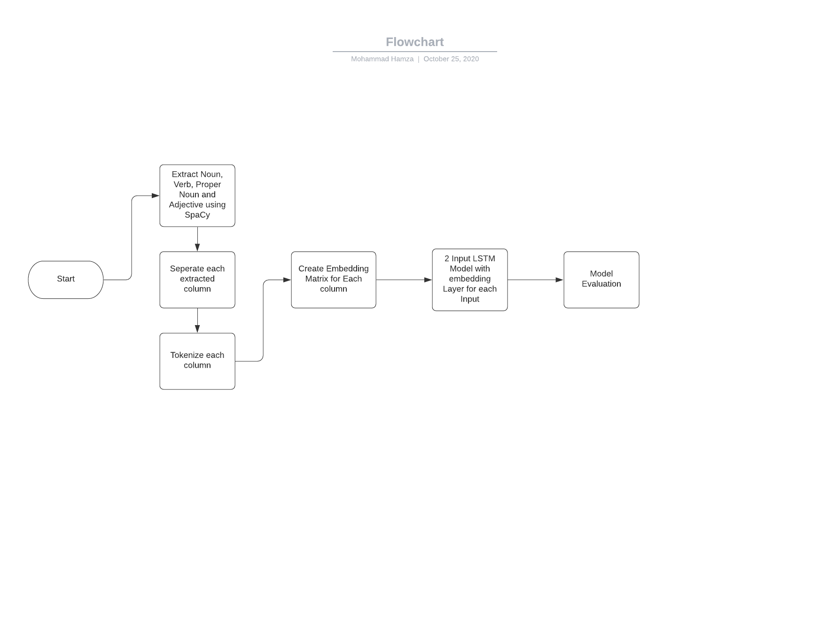

Slide 6
Final Outcome
Model Loss: 0.5271
Accuracy: 0.7474
f1_score = 0.7034

Slide 7
Additional things that can be added.
Tag Data with intents such as (Query, Task, etc)
Deal with Data Imbalance
Use BERT Transformers to identify intent of questions(Could not find pre-trained model which I could use)
Use Intent and Keywords on seperate model to find similarity
Use different architectures
Check Accuracy on Machine Learning Algorithms

